Slide 1



Loading…

Slide 2



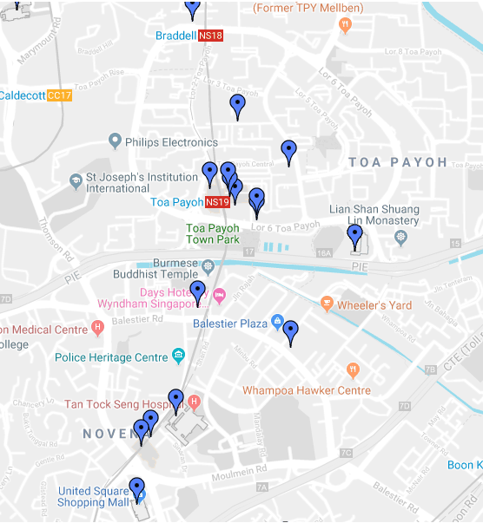




Healthy Eateries
Tap here to search for a eatery
Sort by:
Map View
Distance:
2 km
Favourite
Eateries
Caterers
HCS Products

Slide 3
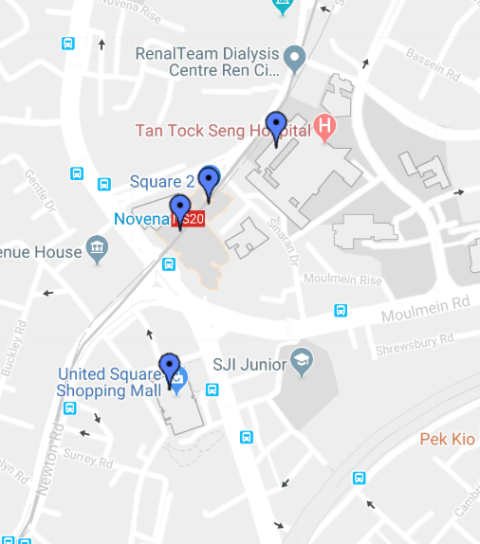

Healthy Eateries
User select the pin drop that turned red. Information of the location will be shown
Save button is for adding to “Saved” list
Feedback is for user to comment (e.g. if eatery is closed).
Tap here to search for a eatery
Sort by:
Map View
Distance:
2 km
Name: Kopitiam – TTSH Building Name: Tan Tock Seng Hospital (TTSH)
Street Name: Jalan Tan Tock Seng
Postal Code: 308433
Floor Number: 1
Unit Number: 13/14/15
Save
Feedback
Favourite
Eateries
Caterers
HCS Products

Slide 4
Feedback on Eateries
Name
This is the feedback page
Contact No.
Email Address
Feedback
Submit
Favourite
Eateries
Caterers
HCS Products

Slide 5


User can sort by :
Map View
List View – A – Z
List View – Z – A
This is List View style
This sorting method will also be used for sorting caterers.
If one of the result is selected by user, the UI will be same as Slide 3
Healthy Eateries
Tap here to search for a eatery
Sort by:
List View: A - Z
Distance:
2 km
A-ONE Vivo City 98585
A-ONE The Seletar Mall 797653
Saved
Nearby
Eateries
Caterers
HCS Products

Slide 6
Healthy Eateries
If user search a location and the sort by is “List View – A – Z”, it will be in list view form
McDonald's
Sort by:
List View: A - Z
Distance:
2 km
McDonald's - Ang Mo Kio Park Blk 10 Ang Mo Kio Street 12 567740
McDonald's - Bishan Park Blk 1378 Ang Mo Kio Ave 1 569981
Saved
Nearby
Eateries
Caterers
HCS Products

Slide 7
Healthy Eateries
Otherwise, if map view is selected, it will be a map view of all McDonalds.
McDonald's
Sort by:
Map View
Distance:
2 km
Favourite
Eateries
Caterers
HCS Products

Slide 8
Healthy Eateries
Ben and Jerry’s
Sort by:
List View: A - Z
Distance:
2 km
No Results Found!
Saved
Nearby
Eateries
Caterers
HCS Products

Slide 9
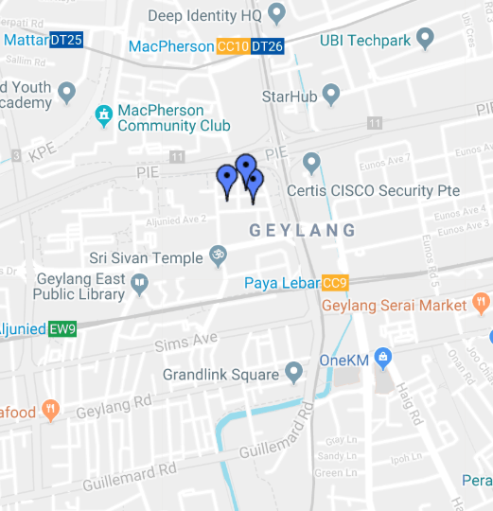
Healthy Caterers
Tap here to search for a caterer
Sort by:
Map View
Distance:
2 km
Favourite
Eateries
Caterers
HCS Products

Slide 10
Healthy Caterers
Tap here to search for a caterer
Sort by:
Map View
Distance:
2 km
Name: AM Chef Catering – Aljunied Industrial Estate Building Name: Aljunied Industrial Estate
Street Name: Aljunied Avenue 4
Postal Code: 389909
Floor Number: 1
Unit Number: 4
Save
Feedback
Favourite
Eateries
Caterers
HCS Products
Notes:
Name: AM Chef Catering – Aljunied Industrial Estate Building Name: Aljunied Industrial Estate
Street Name: Aljunied Avenue 4
Postal Code: 389909
Floor Number: 1

Slide 11




HCS Food Products
User can choose the food category from here. After choosing, a list of products from same category will be displayed.
Else user may search for product via the brand or the product name.
Tap here to search for a product
Seafood
Dairy
Poultry
Sauces
Favourite
Eateries
Caterers
HCS Products

Slide 12
HCS Food Products
Ayam
User search for product via the brand or the product name
Directly from previous slide.
Ayam Brand Chilli Tuna Light Brand: Ayam Brand Weight: 185g
Ayam Brand Club Sardines in Extra Virgin Olive Oil Brand: Ayam Brand Weight: 120g
Seafood
Dairy
Ayam Brand Club Sardines in Extra Virgin Olive Oil & Chilli Brand: Ayam Brand Weight: 120g
Poultry
Sauces
Saved
Nearby
Eateries
Caterers
HCS Products

Slide 13
HCS Food Products
Category:
Seafood
If Seafood category is selected from the category page (Slide 11), results will be in alphabetical order
Sort by:
A - Z
Tap here to search for a eatery
Seafood
Ayam Brand Chilli Tuna Light Brand: Ayam Brand Weight: 185g
Ayam Brand Club Sardines in Extra Virgin Olive Oil Brand: Ayam Brand Weight: 120g
Ayam Brand Club Sardines in Extra Virgin Olive Oil & Chilli Brand: Ayam Brand Weight: 120g
Ayam Brand Mackerel in Tomato Sauce Brand: Ayam Brand Weight: 120g
Favourite
Eateries
Caterers
HCS Products

Slide 14
Favourite
Filter By:
Saved Eateries
Saved Eateries
McDonald's - Ang Mo Kio Park Blk 10 Ang Mo Kio Street 12 567740
Delete
McDonald's - Bishan Park Blk 1378 Ang Mo Kio Ave 1 569981
Delete
Favourite
Eateries
Caterers
HCS Products

Slide 15


Settings
Push Notification
Allow push notification when new eatery is added
Allow push notification when new caterer is added
Favourite
Eateries
Caterers
HCS Products

